Slide 1
Object Oriented Programming (OOP)
August 19, 2016

Slide 2
Objects and Classes
Encapsulation and Data Hiding
Message Passing
Inheritance
Polymorphism
Generalization and Specialization
Links and Associations
Aggregation or Composition
Benefits of Object Model

Slide 3
Objectives
Learn the fundamentals of Object Oriented Concepts
How object oriented concepts are useful in reusability and scalability.
Mechanism in java to implement these object oriented concepts

Slide 4
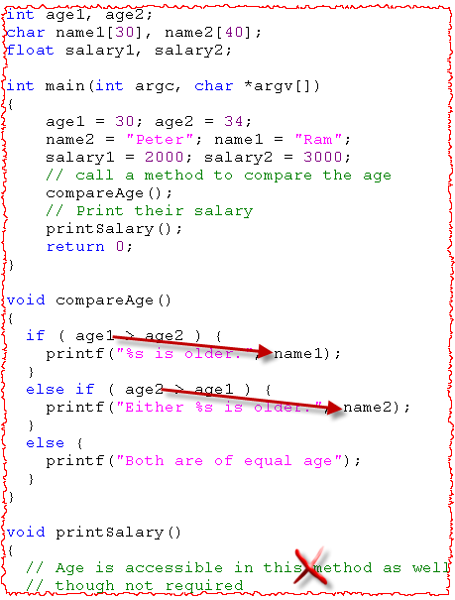
Procedural vs. OO Programming
Programming involves
Data (Attribute/Variables)
Behavior (Function/Proc/Method)
Procedural Programming
The data and behaviors are normally separated.
The programmer needs to remember which code applies to which data.
No control over data (any code can modify it) so testing, debugging more difficult.
Notes:
Before object oriented programming (OOP), everything was based on functions and variables.
“How to achieve” was the primary concern. Resources were added in the middle whenever required.
A lot of changes were required for a requirement addition or a requirement change.
In non-object-oriented languages, when managing information about objects you have to define variables for describing these objects. For instance, if you know that you will manage information about students, you will try to declare the variables required for managing the student information. In our program on the slide, we need to store the information on student name and age. We do it in the part of the program reserved for variable declaration. All the operations on the students are defined in the special code part. This code part is detached (free-standing) from the variable declaration. When programming, the programmer must first remember which variable applies to which object, and which variable should be used in which operation.
This way of programming is difficult to read, understand and modify. It is very error-prone and it leads to highly non maintainable code.

Slide 5
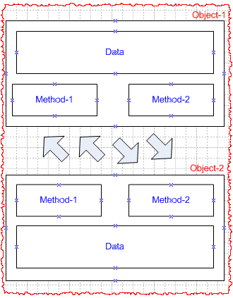
Procedural vs. OO Programming (Contd..)
OO Programming
Based on real-life scenarios. Objects are the building blocks.
The data and the operation that manipulate the data are encapsulated in the object.
The objects communicate with each others through methods and change ‘only’ its own data.

Slide 6



What is a Class and its Object?
A class is a blueprint / template from which individual objects are created.
For ex. All the actors are built from the same set of blueprints and contain the same components.
Classes describe the kinds of state and behavior that objects of it’s type support.
Things an object knows about itself
Instance Variables (State)
Things an object can do
Methods (Behavior)
One Class
Operates on
Many Objects
Notes:
http://download.oracle.com/javase/tutorial/java/concepts/class.html
What is an object? Let us preliminarily say that an object is an instance of a specific type of a thing. An example of an object is Eric who is an instance of a student. The object may be one of the many instances of the same thing.
Within modelling, however, it would be more appropriate to say that an object is something we wish to hold information about. For instance, we wish to manage different types of courses at SU. Hence, we need create objects in which we will be able to store information about courses. Please observe that each object holds information about a different course.
An object can be either concrete like a student, a course or a book, or abstract like a feeling, for instance, information about love of some students to some courses. In many modelling situations, we are in the need to record information about emotions, feelings, or other abstract and intangible phenomena.

Slide 7
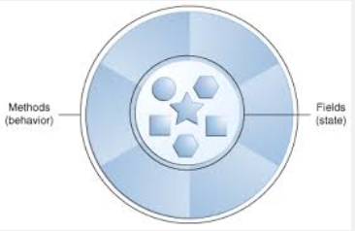
What is Object
Any entity that has state and behavior is known as an object.
For example: chair, pen, table, keyboard, bike etc. It can be physical and logical.
Objects can be modelled according to the needs of the application.
Bundling code into individual software objects provides a number of benefits, including:
Modularity: The source code for an object can be written and maintained independently of the source code for other objects.
Information-hiding: By interacting only with an object's methods, the details of its internal implementation remain hidden from the outside world.
Code re-use: If an object already exists (perhaps written by another software developer), you can use that object in your program.
Plug ability and debugging ease: If a particular object turns out to be problematic, you can simply remove it from your application and plug in a different object as its replacement.

Slide 8
Exercise – Identify classes and objects
Identify the classes and objects in following problem statement:
Sapient has three business units – Global Markets, Nitro and Government Services. Each business unit has projects and projects in-turn have employees. Few employees are managers. A project has mix of both employees and managers.

Slide 9
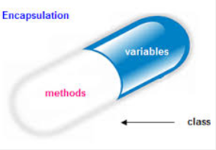
Encapsulation And Data (Information) Hiding
A mechanism of wrapping the data (variables) and code acting on the data (methods) together as a single unit.
In encapsulation the variables of a class will be hidden from other classes, and can be accessed only through the methods of their current class, therefore it is also known as data hiding.
To achieve encapsulation in Java
Declare the variables of a class as private.
Provide public setter and getter methods to modify and view the variables values.
Benefits of Encapsulation:
The fields of a class can be made read-only or write-only.
A class can have total control over what is stored in its fields.
The users of a class do not know how the class stores its data. A class can change the data type of a field and users of the class do not need to change any of their code.

Slide 10

Data Hiding
An object should not disclose all its attributes and behaviors.
It should reveal only the required methods which the other object require to interact with.
These methods which need to be exposed to other objects define the interface of the class.
For ex. An object to sort a list of employees should only expose the method which accepts list of employees as parameter and the algorithm to sort the employees should be hidden from the other object.

Slide 11
Encapsulation is not Information Hiding
Encapsulation is just the container we need to place our similar items like fields and methods, While Data Hiding is protecting your data from outside world (Clients and Consumers)
Data Hiding is not possible without Encapsulation. You can't hide your data without putting it in some form of container. But yes Encapsulation is possible without hiding your data. Put all things public and you can the see the affect.
Keeping instance variable and getters/setters methods as public is still Encapsulation but this way we are not achieving Data Hiding.

Slide 12
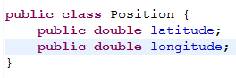
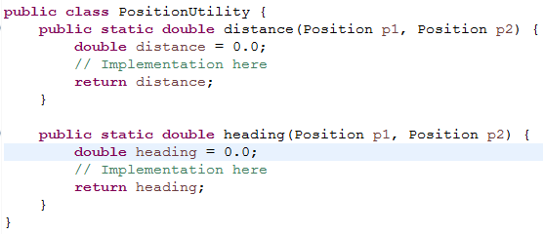
Encapsulation is not Information Hiding (Contd..)
Consider a class Position-
At present Position is nothing but a bag of data.
To utilize those objects of Position, class PositionUtility contains methods for calculating the distance and heading.
Are Position and PositionUtility are not properly Object Oriented though JAVA is OO language ??? – NO
Here position is simple data structure and PositionUtility is repository of mehtods.

Slide 13
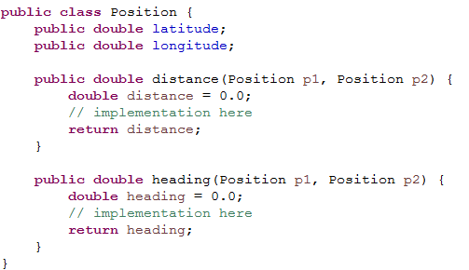
Encapsulation is not Information Hiding (Contd..)
Bundle the data with methods in Position class:
This bundling is called Encapsulation.
As of now it do not provide any data protection or security.

Slide 14
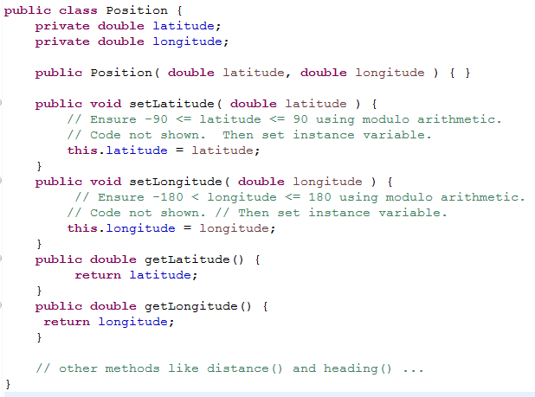
Encapsulation is not Information Hiding (Contd..)
Restrict the acceptable values of latitude and longitude through public setters.
Here Data (Information) hiding is implemented through Encapsulation..

Slide 15
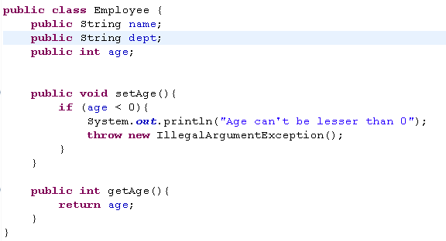
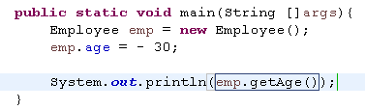
Why Data Hiding is Important
Let’s look at below example
Now consider below main method:

Slide 16

Why Data Hiding is Important (Contd..)
In main method below line is offending -
emp.age = - 30;
We just have an employee with negative age??
To avoid such errors, Keep the information (variables) hidden (private) from outer world and expose setter behaviors where a level of control can be implemented.
Like we have the public setAge() method where in we are throwing IllegalArgumentException in case someone tries to set illegal value to age.

Slide 17
Message Passing
OBJECT A
Communication mechanism between objects.
Company object can send message to Employee object through the method call and parameters.
Employee object will send the message back in terms of the response to the calling method.
Any application requires a number of objects interacting in a harmonious manner. Objects in a system may communicate with each other using message passing. The features of message passing are:
Message passing between two objects is generally unidirectional.
Message passing enables all interactions between objects.
Message passing essentially involves invoking class methods.
Objects in different processes can be involved in message passing.
State
Behavior
Message
State
Behavior
OBJECT B

Slide 18
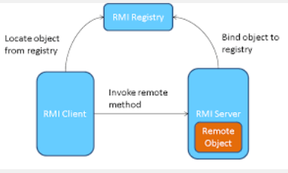
Message Passing helps in Loosely Coupled System
A system of processes in which interaction are solely through messages is often called Loosely-Coupled system.
Example is RMI (Remote Method Invocation) – Remote Method Invocation (RMI) allows a Java object executes on one machine to invoke a method of a java object that executes on another machine.
In a loosely coupled system hardware and software may interact but they are not dependent on each other to work.

Slide 19

Inheritance
Inheritance is a way to form new classes using classes that have already been defined.
Helps in reusing existing code.
Helps in defining the relationship between classes.
Is-A Relationship.
For ex.
Civil Engineer is an Engineer.
Manager is an Employee.
Lion is an Animal.
Mountain Bike is a Bicycle.
For more details and code explanation on Inheritance – http://www.tutorialspoint.com/java/java_inheritance.htm

Slide 20
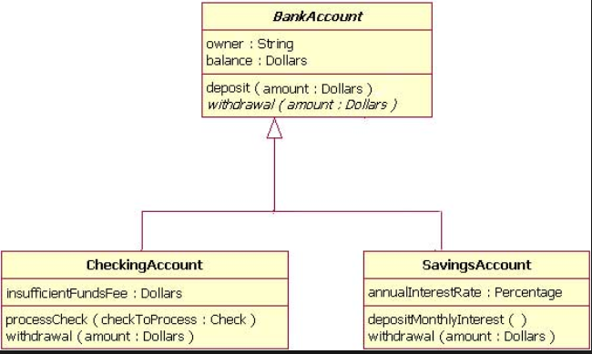
Problem Statement:
Develop an application for Bank Account. Each bank account will have an owner and balance. Users can have two sorts of accounts. Checking Account which additionally have insufficient fund fee and Saving Account which have annual interest rate.
UML Diagram

Slide 21
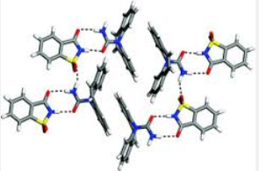
Polymorphism
Polymorphism is the ability of an object to take on many forms. The most common use of polymorphism in OOP occurs when a parent class reference is used to refer to a child class object.
Any Java object that can pass more than one IS-A test is considered to be polymorphic. In Java, all Java objects are polymorphic since any object will pass the IS-A test for their own type and for the class Object.
The reference variable can be reassigned to other objects provided that it is not declared final. The type of the reference variable would determine the methods that it can invoke on the object.
A reference variable can refer to any object of its declared type or any subtype of its declared type. A reference variable can be declared as a class or interface type.
If a method from parent class is overridden in subclass, and object of subclass is referenced by Parent’s class variable, then calling the overridden method from this variable will result in a call to subclass’s method. This is called run time binding. But remember the compiler must see that the same method is available and visible from parent class too.

Slide 22


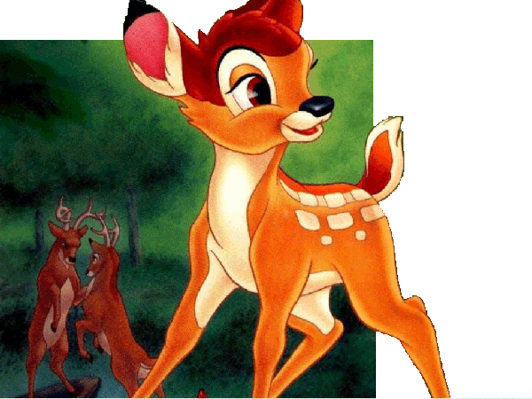



Virtual Safari Example
Problem:
Indian Government came up with an idea to launch a virtual safari on internet. This safari will have Indian animals and birds. The visitors will get real time experience to see different Indian species on net and this will promote Indian tourism.
Your job is to design the different animal classes present in Virtual Safari and let visitors see them doing different things like sleeping, eating etc.
Following six animals are given to start with. The design should be flexible to accommodate new animals.

Slide 23

Step#1 – Look for objects
Having common attributes and behavior.
Instance Variables (Knows)
Name – Animal’s Name
picture – Identifies the animal (by picture).
food – Type of food e.g. grass or meat
hunger – Level of hunger in the animal.
Boundary – Area that animal needs to roam around.
Methods (Behavior)
Speak
Eat
Sleep
Roam

Slide 24

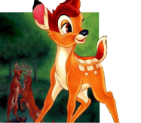



Step#2 – Identify an Animal Class
Class
Identify a class e.g. Animal having the instance variables and methods.
All the animals can be the objects of this class.
Decide if there is some behavior specific to one particular animal?
Speak and eat methods are specific to the Animal.
Sleep and roam behaviors are almost similar to all animals.
Look for inheritance opportunities.
Objects

Slide 25
Step#3 – Identify Subclasses
Different Behavior
Speak and eat methods are overridden in the child classes.
Any more inheritance opportunities?
Hint: Do all above animals roam in the same manner?

Slide 26
Step#4 – Identify More Inheritance Opportunities
Group Roamers – Roam in Groups - Dog, Deer and Elephant.
Single Roamers – Roam alone - Lion, Tiger and Cat.

Slide 27
Method Calls
Elephant elephant = new Elephant();
elephant.speak();
Which “speak” method is called?
Access modifier rules –
private members not inherited.
public members inherited.
protected members inherited.

Slide 28
Polymorphism
Java Heap
Space
Generally
Reference type and object type are same.
Elephant elephant = new Elephant();
But, with Polymorphism -
Reference type and objects type can be different.
Animal animal = new Elephant();
Which method is called*?
Animal animal = new Elephant();
animal.speak();
*Refer diagram in prev slides.
Elephant
elephant
Java Heap
Space
Animal
- Method1
Elephant
Animal
Elephant
Method1
Method2
animal

Slide 29
What is the advantage?
This helps to make
Polymorphic arrays, arguments and return types.
For ex. Lunch time for Animals.
Animal[] animals = new Animal[6];
animals[0] = new Lion();
animals[1] = new Tiger();
animals[2] = new Dog();
animals[3] = new Cat();
animals[4] = new Elephant();
animals[5] = new Deer();
for (int i=0; i < animals.length; i++) {
animals[i].eat();
animals[i].roam();
}

Slide 30
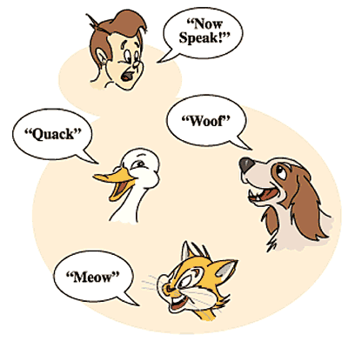
Definition - Polymorphism
Let us now define Polymorphism formally.
Polymorphism is a programming language feature that allows values of different data types to be handled using a uniform interface.
Notes:
http://docs.oracle.com/javase/tutorial/java/IandI/polymorphism.html

Slide 31
Exercise – Animal Classes
Design the animal classes given in the diagram below. The different methods in the classes print an output message like “Lion Roared.” on the console.
Call the lunchTime method to invoke the eat, roam and then sleep methods on Animal objects.

Slide 32
Exercise – Buildings
Design the classes given in the adjoining diagram. There is an approval required before a building can be constructed.
Pvt. Company needs approval from its promoters and local urban development authority (LUDA).
Public listed company needs approval from its shareholders and local urban development authority (LUDA).
Govt. company needs approval from ministry and LUDA.
A house however needs the approval only from LUDA.
Write a program having the list of buildings and then it calls the approvalRequired method to display the approvals required for each building.
Demostrate “BuildingsTest” example.

Slide 33

Advantages of Polymorphism
Same interface could be used for creating methods with different implementations
Reduces the volume of work in terms of distinguishing and handling various objects
Supports building extensible systems
Complete implementation can be replaced by using same method signatures
Code Reusability
Common resources could well be shared instead of duplicating them in each time of execution.
Readability and understandability.

Slide 34
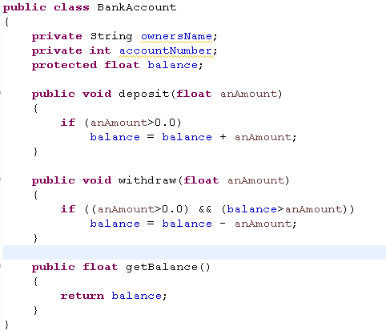
Static and Dynamic Polymorphism
Static Binding is compile-time Binding also known as early binding.
Achieved by Method Overloading (in same class)
Dynamic Binding is run-time binding also known as late binding.
Achieved by Method Overriding (in different classes of a hierarchy)
Method Overriding Example:
Consider our classic BankAccount example which is Super Class for Saving Account and Currenct Account
BankAccount has two methods deposit and withdraw.
See the SavingAccount code in next slide.

Slide 35
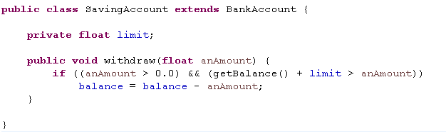
SavingAccount class with limits
A superclass reference can refer to an instance of the superclass OR an instance of ANY class which inherits from the superclass
Note that Withdraw method from BankAccount is Overloaded here.
BankAccount anAccount = new BankAccount(123456, "Craig");
BankAccount account1 = new SavingAccount(3323, "John", 1000.0);
BankAccount
name = "Craig"
accountNumber = 123456
SavingAccount
name = "John"
accountNumber = 3323
limit = 1000.0
anAccount
account1

Slide 36
In the previous slide, the two variables are defined to have the same type at compile time: BankAccount
However, the types of objects they are referring to at runtime are different
What happens when the withdraw method is invoked on each object?
anAccount refers to an instance of BankAccount. Therefore, the withdraw method defined in BankAccount is invoked.
account1 refers to an instance of OverdraftAccount. Therefore, the withdraw method defined in OverdraftAccount is invoked.
Runtime Binding: The method being invoked on an object is determined AT RUNTIME and is based on the type of the object receiving the message.

Slide 37
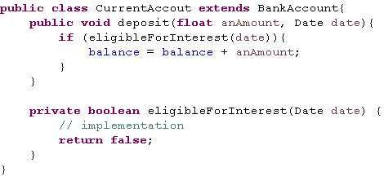
Static Binding (Method Overloading) Example
In another implementation of BankAccount say Current Account, during deposit we pass date too to calculate if deposited amount is interest eligible for this month or not.
BankAccount
CurrentAccount
See how deposit method is overloaded and not overridden. This is compile time binding.

Slide 38
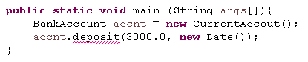
Try to run the below main method:
This will throw a compile time error as deposit(float , Date) method is not visible to BankAccount class and we are referring CurrentAccount object from BankAccount variable here.
OverLoading Rules:
Overloaded methods MUST change the argument list.
Overloaded methods CAN change the return type.
Overloaded methods CAN change the access modifier.
Overloaded methods CAN declare new or broader checked exceptions.
A method can be overloaded in the same class or in a subclass.

Slide 39
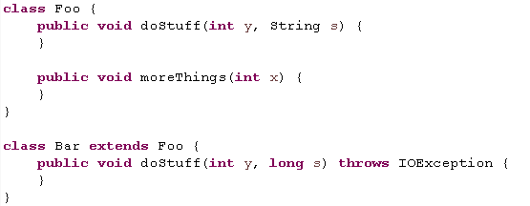
Be careful to recognize when a method is overloaded rather than overridden. You might see a method that appears to be violating a rule for overriding, but that is actually a legal overload, as follows:
It's tempting to see the IOException as the problem, because the overridden doStuff() method doesn’t declare an exception, and IOException is checked by the compiler.
But the doStuff() method is not overridden! Subclass Bar overloads the doStuff() method, by varying the argument list, so the IOException is fi ne.

Slide 40
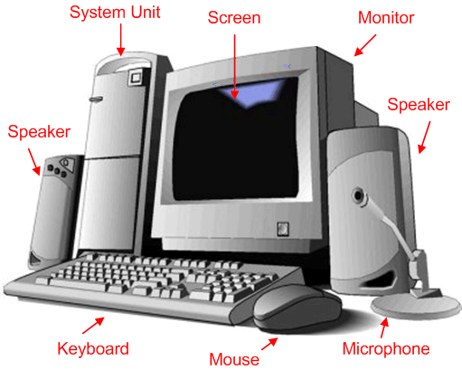
Links and Associations
Link- A link represents a connection through which an object collaborates with other objects. Through a link, one object may invoke the methods or navigate through another object. A link depicts the relationship between two or more objects.
Association –
Association represent the relationship between objects.
An object wants another object to perform a service for it.
Computer system is composed of monitor, keyboard, mouse and system box.
Meeting room is composed of chairs, table, phone etc.

Slide 41
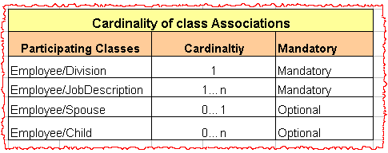
Cardinality
It specifies how many times (minimum and maximum) an entity is related to another entity in a given relationship.
Three types of Cardinality ratio:
One-to-one: Single object of class A is associated with a single obhject of class B.
One–to–Many : A single object of class A is associated with many objects of class B.
Many–to–Many : An object of class A may be associated with many objects of class B and conversely an object of class B may be associated with many objects of class A.
Determine the cardinality by asking following questions -
Which objects collaborate with other objects?
How many objects participate in the collaboration?
Is the collaboration optional or mandatory?

Slide 42
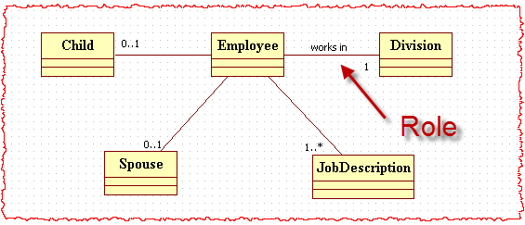
Cardinality – UML Notation
Cardinality is indicated along the association lines.
A role identifies the meaning for the association end and it is used to navigate to an object of the other class to the association.

Slide 43
Generalization and Specialization
Specialization:
Specialization and generalization is the subclass and superclass hierarchy in java inheritance concepts.
Specialization is the process of sub classing a superclass entity on the basis of some distinguishing characteristic of the entity in the superclass. The reason for creating such hierarchical relationship is that:
Certain attributes of the superclass may apply to some but not all.
Generalization:
Generalization is the bottom-up process of abstraction.
In generalization we club the differences among entities according to the common feature and generalize them into a single superclass.
The original entities are thus subclasses of it.
In simple terms, it is just the reverse of specialization, which is a top-down process whereas generalization is bottom up.

Slide 44
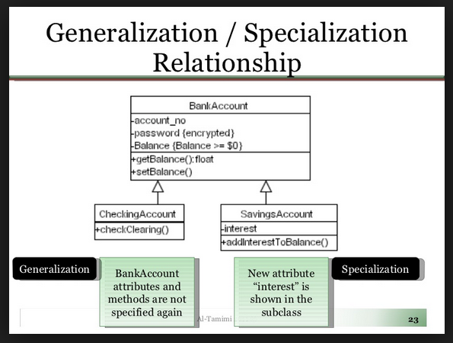
Generalization and Specialization (Contd..)
Bank Account is generalization
Saving Account is Specialization

Slide 45
When to use Generalization and Specialization
In above example, Observe that each Account (Saving and Current) has common field (account number) and common methods getBalance() and setBalance(). So keeping these common fields/behavior in one class is Generalization
Also notice that Current Account and Saving Account has differences like Saving Account has interest and Current Account might have other charges. So segregating the specific members or behavior in specialized class is Specialization.
Use Generalization when you have common members/Behavior that are applicable to two or more classes.
Use Specialization when you have new members/behavior specific to this class.

Slide 46

Aggregation and Composition
Composition and Aggregation are types of associations. They are very closely related and in terms of programming there does not appear much difference.
Aggregation:
Only see the whole.
A complex object composed of other objects.
TV composed of transistor, picture tube, tuner etc.
The object exists outside the other, is created outside, so it is passed as an argument (for example) to the constructor.

Slide 47
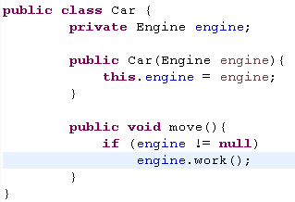

Aggregation and Composition (Contd..)
Ex- Car– Engine. The engine is created in a different context and than becomes a Car’s property.
Composition:
Strong containment property.
Object only exists, or only makes sense inside the other, as a part of the other.
Ex.- Person and Heart.

Slide 48
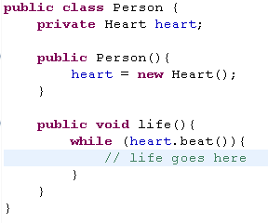
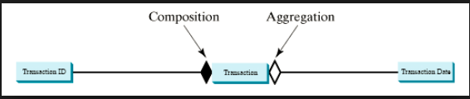
Aggregation and Composition (Contd..)
Ex: People – heart. You don’t create a heart and than passes it to a person. Ex.-
Heart is created inside the Person constructor only.
UML Representation:

Slide 49
Composition
Hand
is_part_of
Crate
*
has
A finger cannot exist on its own
A bottle of beer can exist on its own
Finger
is_part_of
*
1
has
Nail
Beer Bottle
Composition
Strong containment propery
Aggregation
Weak containment property

Slide 50
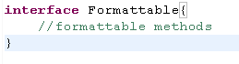
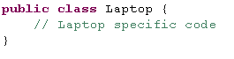
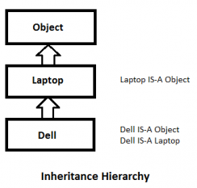
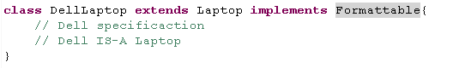
When to use inheritance and aggregation
If the new class is more or less as the original class. Use inheritance. The new class is now a subclass of the original class.
If the new class must have the original class. Use aggregation. The new class has now the original class as a member.
Inheritance can be implemented with extends (in case of class) and implements(in case of interface) keywords.
Example: IS-A relation: Dell IS-A Laptop
Any class that passes the IS-A relationship with another class, use inheritance.

Slide 51
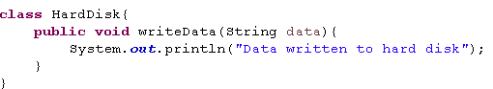
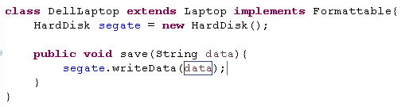

When to use inheritance and aggregation (Contd..)
Any Class passes HAS-A relationship for another object, use aggregation or composition.
Ex: Dell IS-A Laptop and it HAS-A Hard Disk.
See how Dell laptop has access to HardDisk’s writeData() method.

Slide 52

Benefits of Object Models
Now that we have gone through the core concepts pertaining to object orientation, it would be worthwhile to note the advantages that this model has to offer.
The benefits of using the object model are:
It helps in faster development of software.
It is easy to maintain. Suppose a module develops an error, then a programmer can fix that particular module, while the other parts of the software are still up and running.
It supports relatively hassle-free upgrades.
It enables reuse of objects, designs, and functions.
It reduces development risks, particularly in integration of complex systems

Slide 53
Recap
Procedural and Object Oriented language differences.
Class and Object
Class is blue print from which we can create Objects with their own values.
Class contains both- variables and methods.
Objects has state and behavior.
Encapsulation and Data Hiding
A mechanism of wrapping data and methods is called encapsulation.
To achieve encapsulation in Java
Declare the variables of a class as private.
Provide public setter and getter methods to modify and view the variables values.
Data Hiding
An object should not disclose all its attributes and behaviors.
Give you some control through which you can prevent some errors while setting the variables data.

Slide 54
Recap
Message Passing
Communication mechanism between objects.
Any application requires a number of objects interacting in a harmonious manner.
Message passing helps in loosely coupled system
Inheritance
Inheritance is a way to form new classes using classes that have already been defined.
Helps in reusing existing code.
Helps in defining the relationship between classes.
Is-A Relationship.
Polymorphism
Polymorphism is the ability of an object to take on many forms. The most common use of polymorphism in OOP occurs when a parent class reference is used to refer to a child class object.
Any Java object that can pass more than one IS-A test is considered to be polymorphic. In Java, all Java objects are polymorphic since any object will pass the IS-A test for their own type and for the class Object.

Slide 55
Recap
Static and Dynamic Polymorphism
Static Binding is compile-time Binding also known as early binding.
Achieved by Method Overloading (in same class)
Dynamic Binding is run-time binding also known as late binding.
Achieved by Method Overriding (in different classes of a hierarchy)
Links and Associations
A link represents a connection through which an object collaborates with other objects.
Association
Association represent the relationship between objects.
An object wants another object to perform a service for it.
Cardinality
It specifies how many times (minimum and maximum) an entity is related to another entity in a given relationship.
Three types of Cardinality ratio:
One-to-one
One-to-many
Many-to-many

Slide 56
Recap
Generalization and Specialization
Specialization and generalization is the subclass and superclass hierarchy in java inheritance concepts.
Specialization is the process of sub classing a superclass entity on the basis of some distinguishing characteristic of the entity in the superclass. The reason for creating such hierarchical relationship is that:
Certain attributes of the superclass may apply to some but not all.
Generalization
Generalization is the bottom-up process of abstraction.
In generalization we club the differences among entities according to the common feature and generalize them into a single superclass.
The original entities are thus subclasses of it.
In simple terms, it is just the reverse of specialization, which is a top-down process whereas generalization is bottom up.
Aggregation and Composition
When contained object is integral part of container object- aggregation
When contained object is passed to container object and contained object can survive stand alone- Composition.

Slide 57
References
http://docs.oracle.com/javase/tutorial/java/concepts/index.html
http://stackoverflow.com/questions/12013448/encapsulation-vs-data-hiding-java
http://www.developer.com/java/data/implementing-generalization-and-specialization-in-java.html
http://stackoverflow.com/questions/11881552/implementation-difference-between-aggregation-and-composition-in-java
www.tutorialspoint.com/object_oriented_analysis_design/ooad_object_oriented_model.htm

Slide 58
THANK YOU

